Slide 1
Advocacy Toolkit #3: Planning A Meeting With Your Legislator

Slide 2
Make an IMPACT
I – Identify who to meet with M – Make an appointment P – Prepare and practice A – Arrive on time C – Come dressed appropriately T – Talk, but also listen

Slide 3
Identify Who To Meet With
Knowing who you are targeting and why will help make the most out of your visit – for you and the legislator.
Identify your legislators:
www.openstates.org
www.commoncause.org
All state legislatures have a website with a directory
Do your research on your legislator. Great resource: www.legiscan.com

Slide 5
Make An Appointment
Making an appointment ensures you of a designated time to meet with the legislator and that you have their undivided attention.
Contact the office directly by phone or email
Inform them of whom the legislator will be meeting with and why they are meeting
Appointments should be made 2-3 weeks ahead of time and give them a flexible window of time
Meeting with staff members is ok too

Slide 6
To: district39@senate.virginia.gov
From: tim.boyd@rareaction.org
Subject: Meeting Request to Discuss Rare Disease Day
Senator Barker,
My name is Jane Smith, I’m a rare disease advocate and a resident of Danbury, CT. I am writing to request a meeting with you to discuss Rare Disease Day.
Are you or your staff available to meet with me during the week of July 9?
Thank you for your time and please let me know if I can provide additional information. I can be reached via email or by phone at (555) 555-5555.
Sincerely,
Jane Smith

Slide 7
Prepare And Practice
Prepare for a dialogue and practice what you’d like to say and ask ahead of time.
Prepare your message and “leave behind” materials (see Advocacy Toolkit #5)
Identify the key points you want to discuss. If it’s a request (e.g., to attend an event), make sure you have specific details (date, time, location, etc.)
It may help to practice your points out loud with a friend or colleague
If you have multiple people joining you at the meeting, determine who will speak and when. If one of your attendees is a constituent of the legislator you are meeting with, you may want to allow them to be the main speaker for the group.

Slide 8
Arrive On Time
If you are late for your meeting you may not only lose valuable time during your appointment, they could give your spot to someone else.
Arrive at least 15 minutes early. If you are running late, inform the office immediately
Parking is limited and can also be expensive in some states (you may also have to get special permission to access handicap-accessible areas)
Expect a lot of foot traffic and security checks
If you are meeting as a group, designate a planned meeting spot that everyone can easily find
Be prepared for last-minute delays and room changes by your legislator (it happens)

Slide 9
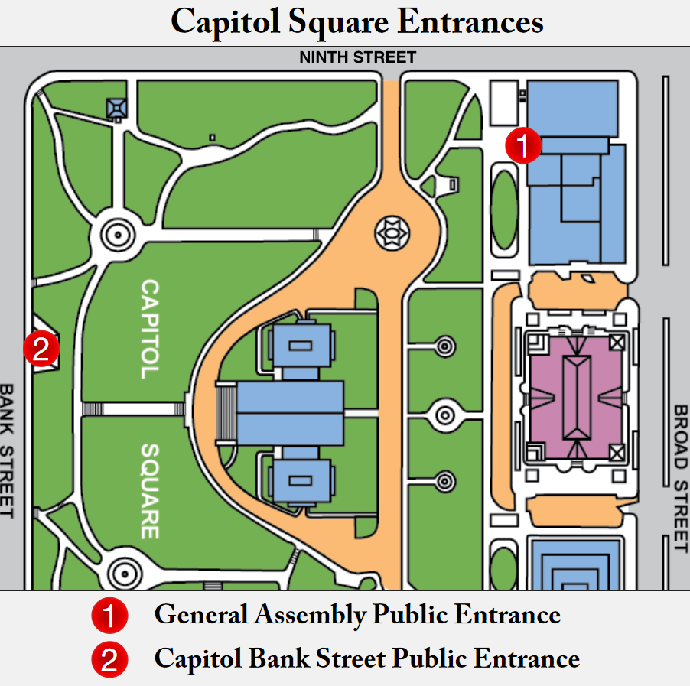

Slide 10
Come Dressed Appropriately
A state office is somewhere you want to be taken seriously. Business attire is appropriate for a meeting and is highly recommended.

Slide 11
Talk, But Also Listen
You should be confident and lead the conversation where you’d like, but also remember that in order to have a good conversation you must also listen.
Engage them with questions or information about the issue you want to discuss
Do your best to keep the conversation on topic
If you do not know the answer to a question, be honest about it. Don’t try to fake an answer
At the end of the meeting, recap any specific requests or actions that were discussed

Slide 12
Share your experience (e.g., I’m a patient, I’m a mother, I’m a clinician, etc.)
Remind them why you are here (e.g., I’m supporting a bill, planning an event, etc.)
Make an actionable request (e.g., vote for this bill, attend our event, etc.)

Slide 13
After Your Meeting
Within 3-5 days of your meeting, follow up in writing with the legislator or their staff:
Be professional – even if they do not agree with your position
Thank them
Restate your issue and highlight what was discussed
Follow up with any unanswered questions they may have had during the meeting
Regroup with your organization and let everyone know how it went.
Formulate a plan to go forward with the issue or direct it from another point of view

Slide 14
To: district39@senate.virginia.gov
Cc: janedoe@senate.virgina.gov
From: tim.boyd@rareaction.org
Subject: Thank You for Meeting With Me
Senator Barker,
Thank you for taking the time to meet with me yesterday, it was a pleasure talking to you about Rare Disease Day. Per your request, here’s further information about our Rare Disease Day event:
The event will be held on Feb 28 at the capitol rotunda from: 10:30 to noon. We would love for you to attend and talk briefly about how the state can support the rare disease community.
Your health care assistant Jane said that if you are not able to attend then she would be happy to speak in your place. We would be happy to have her and appreciate the support.
If you or your staff need further information about the event, please let me know. I can be reached via email or by phone at (555) 555-5555.
Thanks again,
Jane Smith

Slide 15
Final Thoughts
Your legislators (and their staff) want to have an ongoing relationship with you.
Feel free to keep them in the loop about your (or your organization’s) activities.
Keep an eye out for events hosted by your legislator. These are opportunities to quickly see them again and remind them who you are.
Other Advocacy Toolkits:
Toolkit #5: What you need (legislative visit materials)
Toolkit #6: State vs. Federal Government

Slide 16
Thank You!
www.rareaction.org
www.rarediseases.org

